Slide 1
Develop API End Points with Spring Boot for eStore Backend

Slide 2
Develop RestControllers and Microservices

Slide 3





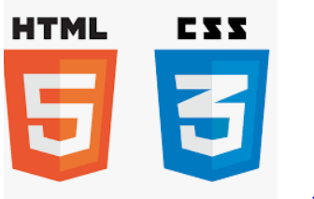

Before we begin, let’s recall what we have covered till now:
Agile
Git
SQL
Angular
HTML
CSS
JavaScript
CoreJava

Slide 4





Before we begin, let’s recall what we have covered till now:
JDBC
JSP
Servlets
MongoDB
Maven

Slide 5





Before we begin, let’s recall what we have covered till now:
JUnit
Spring
Spring Boot
Webservices
Microservices

Slide 6
Create Spring Boot Project
Create and setup a Spring Boot Project using Spring Starter
Configure the dependencies for Web and DB
Models and Repository
Copy the existing models
Annotate the Modes using JPA for CRUD operations
Develop Repository Interfaces for various models using CrudRepository interface

Slide 7
Configure Server and DB Details
Configure server port in application.properties file
Configure URL, username, password, and driver class in application.properties file
Build and Execute
Build and execute the Maven Web App Project
Package the web project as a war file

Slide 8
As a full stack web developer, our key role is to develop both client and server software.
Angular and Node can be used to build front end of the web page.
Spring Boot, Java, and MySQL or MongoDB can be used to build at the back end.

Slide 9

Now, Bob needs to develop API end points with Spring Boot for E-Store Backend. So, Bob brainstorms a bit and finds a solution.
Let me use Spring, Spring Boot, WebServices and MicroServices to create a Spring Boot Project. And Spring Web and JDBC Dependencies to configure configure this project.
In this lesson, we will create Controller Classes and implement CRUD operations by creating microservices for various models. The Request will be captures and JSON Response will be sent back to the client. Finally, we will test the services on postman and help Bob to complete his task effectively and quickly.

Slide 10

Create Controller Classes
Implement Microservices with web methods and use annotations accordingly
Build and Run and package the Backend Project
Test the Services using Postman for Request and Response

Slide 11
Create Controllers
Notes:
Now we will create various Java Classes to serve as controller which will process request and response using to perform CRUD Operations for eStore Backend Project.

Slide 12
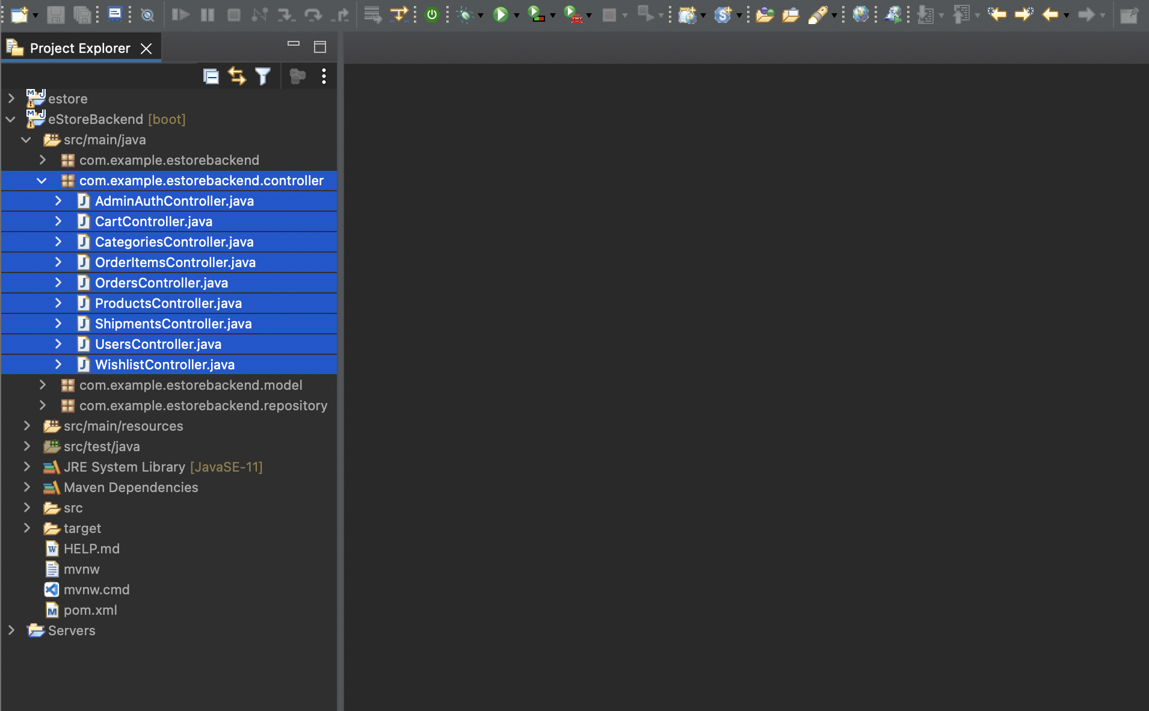
Create Java Classes as Controllers
An overview of Controller Classes, which will be created in the project structure:
Notes:
Overview of Controller Classes which will be created in our project structure:

Slide 13
Create Java Classes as Controllers
UsersController.java: Servlet for HTTP request response for user, which will manage CRUD operations using estorerepository
Notes:
Overview of Controller Classes which will be created in our project structure:
UsersController.java
Servlet for HTTP Request Response for User which will manage CRUD Operations using EStoreRepository

Slide 14
Create Java Classes as Controllers
CategoriesController.java: Servlet for HTTP request response for product categories, which will manage CRUD operations using estorerepository
Notes:
CategoriesController.java
Servlet for HTTP Request Response for Product Categories, which will manage CRUD Operations using EStoreRepository

Slide 15
Create Java Classes as Controllers
OrdersController.java: Servlet for HTTP request response for orders placed by users, which will manage CRUD operations using estorerepository
Notes:
OrdersController.java
Servlet for HTTP Request Response for Orders placed by Users, which will manage CRUD Operations using EStoreRepository

Slide 16
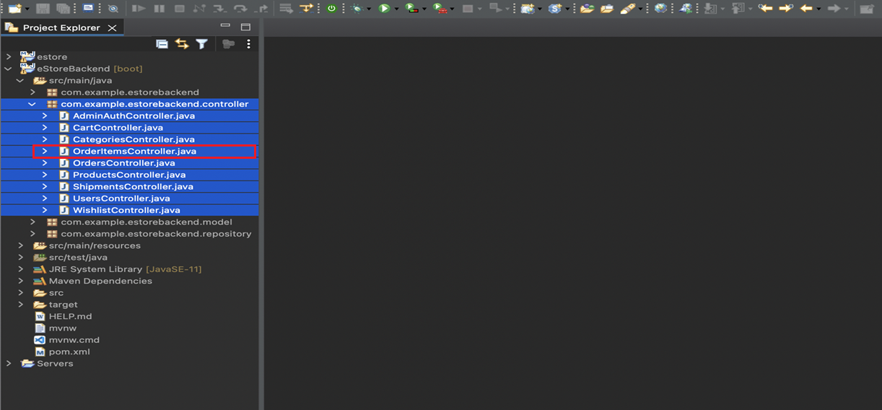
Create Java Classes as Controllers
OrderItemsController.java: Servlet for HTTP request response for items in an order, which will manage CRUD operations using estorerepository
Notes:
OrderItemsController.java
Servlet for HTTP Request Response for items in an order, which will manage CRUD Operations using EStoreRepository

Slide 17
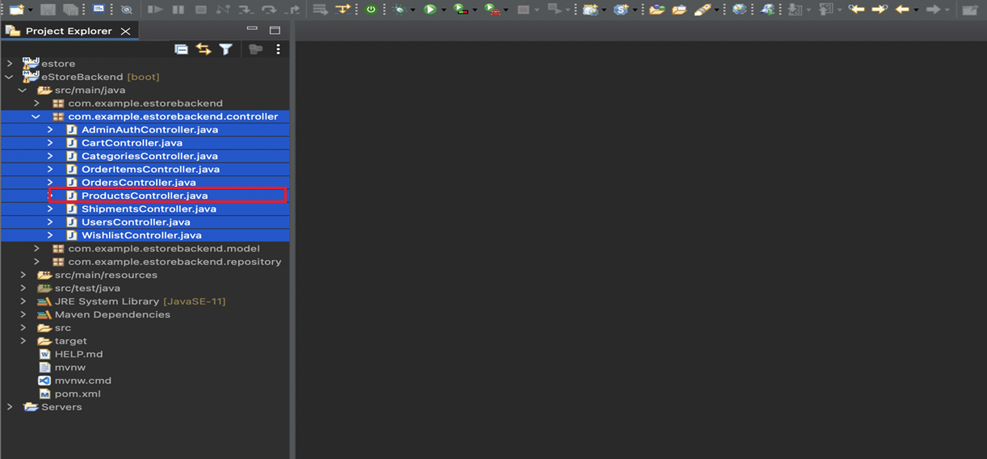
Create Java Classes as Controllers
ProductsController.java: Servlet for HTTP request response for products in the estore, which will manage CRUD operations using estorerepository
Notes:
ProductsController.java
Servlet for HTTP Request Response for Products in the estore, which will manage CRUD Operations using EStoreRepository

Slide 18
Create Java Classes as Controllers
ShipmentsController.java: Servlet for HTTP Request Response for shipments of the orders placed by Users, which will manage CRUD Operations using EStoreRepository
Notes:
ShipmentsController.java
Servlet for HTTP Request Response for shipments of the orders placed by Users, which will manage CRUD Operations using EStoreRepository

Slide 19

Create Java Classes as Controllers
CartController.java: Servlet for HTTP Request Response for Shopping Cart of the User, which will manage CRUD Operations using EStoreRepository
Notes:
CartController.java
Servlet for HTTP Request Response for Shopping Cart of the User, which will manage CRUD Operations using EStoreRepository

Slide 20

Create Java Classes as Controllers
WishlistController.java: Servlet for HTTP Request Response for Wishlisted Products by user, which will manage CRUD Operations using DAO
Notes:
WishlistController.java
Servlet for HTTP Request Response for Wishlisted Products by User, which will manage CRUD Operations using DAO

Slide 21
UsersController.java: Implementation as RestController for Users
UsersController class will handle HTTP Request and Response from the client to perform various CRUD Operations for users.
@RestController
@RequestMapping("/users")
public class UsersController {
// implement web methods here
}
@RequestMapping will have path as users to reach to the controller
Notes:
UsersController class will handle HTTP Request and Response from the client to perform various CRUD Operations for Users.
Annotate with @RestController to mark it as a controller
@RequestMapping will have path as users to reach to the controller

Slide 22
Create Microservice in Controller for CRUD Operations
Notes:
Now we will create various Java Classes to serve as controller which will process request and response using to perform CRUD Operations for eStore Backend Project

Slide 23
Implementating Micorservice for CRUD: Insert Operation
Perform an insert operation inside our RestController.
Create UsersRepository reference.
@RestController
@RequestMapping("/users")
public class UsersController {
@Autowired
UsersRepository repository;
final String TAG = "User";
Annotate UsersRepository with @Autowired to perform CRUD Operations.
Notes:
Let us see, how can we perform an insert operation inside our RestController.
Create UsersRepository reference and annotate it with @Autowired. We need this to perform CRUD Operations.

Slide 24
Implementating Micorservice for CRUD: Insert Operation
Create a method such as addUser.
Use annotation @PostMapping with the path as add.
@PostMapping(path= "/add")
public Response<Users> addUser(@RequestParam String email, @RequestParam String password, @RequestParam String fullName, @RequestParam String street, @RequestParam String city,
@RequestParam String state, @RequestParam String country, @RequestParam Integer pincode, @RequestParam String image, @RequestParam Long contact) {
Date date = new Date();
Notes:
Create a method eg: addUser and use the annotation @PostMapping with the path as add

Slide 25
Implementating Micorservice for CRUD: Insert Operation
Use inputs in the method and mark them as @RequestParam to read data from the client in the HTTP Request.
Use the CrudRepository command and execute the save method.
Users user = new Users(null, email, password, fullName, street, city, state, country, pincode, image, contact, date);
repository.save(user);
return new Response<Users>(101, TAG+" Saved Successfully at "+date, null);
}
}
Return the Response Object from addUser Method with code and message, which will be sent as JSON to client in response.
Notes:
Now, take the inputs in the method and mark them @RequestParam so as to read data from the client in the HTTP Request
Use the CrudRepository and execute the save method
Return the Response Object from the addUser Method with code and message, which will be sent as JSON to client in response

Slide 26
Implementating Micorservice for CRUD: Update Operation
Perform an update operation inside our RestController.
@RestController
@RequestMapping("/users")
public class UsersController {
@Autowired
UsersRepository repository;
Notes:
Let us see, how can we perform an update operation inside our RestController.

Slide 27
Implementating Micorservice for CRUD: Update Operation
Use inputs in the method and mark them as @RequestParam to read data from client in HTTP Request and take ID as additional input to perform update.
Create a method such as updateUser.
Use annotation @PostMapping with the path as update.
@PostMapping(path= "/update")
public Response<Users> updateUser(@RequestParam Integer userId, @RequestParam String email, @RequestParam String password, @RequestParam String fullName, @RequestParam String street, @RequestParam String city,
@RequestParam String state, @RequestParam String country, @RequestParam Integer pincode, @RequestParam String image, @RequestParam Long contact) {
Date date = new Date();
Notes:
Create a method eg: updateUser and use the annotation @PostMapping with the path as update
Now, take the inputs in the method and mark them @RequestParam so as to read data from the client in the HTTP Request. We will take ID as additional input based on which we can perform the update.

Slide 28
Implementating Micorservice for CRUD: Update Operation
Use the CrudRepository method and execute the same save method to do an update as the object contains ID.
Users user = new Users(userId, email, password, fullName, street, city, state, country, pincode, image, contact, date);
repository.save(user);
return new Response<Users>(101, TAG+" Updated Successfully at "+date, null);
}
}
Return the Response Object from the updateUser Method with code and message, which will be sent as JSON to client in response.
Notes:
Use the CrudRepository and execute the same save method to do an update as the object contains id also now
Return the Response Object from the updateUser Method with code and message, which will be sent as JSON to client in response

Slide 29
Implementating Micorservice for CRUD: Retrieve Operation
Perform a retrieve operation inside the RestController.
@RestController
@RequestMapping("/users")
public class UsersController {
@Autowired
UsersRepository repository;
final String TAG = "User";
Notes:
Let us see, how can we perform an retrieve operation inside our RestController.

Slide 30
Implementating Micorservice for CRUD: Retrieve Operation
Create a method such as getUsers.
@GetMapping(path="/get")
public Response<Users> getUsers(){
Use the annotation @GetMapping with the path as get.
Notes:
Create a method eg: getUsers and use the annotation @GetMapping with the path as get

Slide 31
Implementating Micorservice for CRUD: Retrieve Operation
Create an ArrayList.
Use the CrudRepository and execute the findAll method to get all the objects from the table.
ArrayList<Users> list = new ArrayList<Users>();
repository.findAll().forEach((user) -> list.add(user));
Date date = new Date();
return new Response<Users>(101, list.size()+" "+TAG+"s Fetched Successfully at "+date, list);
}
}
Return the Response Object from the getUsers method with code, message, and list, which will be sent as JSON to the client in response.
Notes:
Now, create an ArrayList
Use the CrudRepository and execute the findAll method to get all the objects from the Table
Return the Response Object from the getUsers Method with code, message and list which will be sent as JSON to client in response

Slide 32
Implementating Micorservice for CRUD: Retrieve Single Operation
Perform a retrieve single operation inside the RestController.
@RestController
@RequestMapping("/users")
public class UsersController {
@Autowired
UsersRepository repository;
final String TAG = "User";
Notes:
Let us see, how can we perform an retrieve single operation inside our RestController.

Slide 33
Implementating Micorservice for CRUD: Retrieve Single Operation
Create a method such as getUserById.
@GetMapping(path = "/get/{id}")
public Response<Users> getUserById(@PathVariable("id") Integer id){
Use the annotation @GetMapping with the path as get/{id}, where id is a path variable.
Notes:
Create a method eg: getUserById and use the annotation @GetMapping with the path as get/{id}, where id is a path variable

Slide 34
Implementating Micorservice for CRUD: Retrieve Single Operation
Create an ArrayList.
Use the CrudRepository and execute findById method to get a single object from table based on ID.
ArrayList<Users> list = new ArrayList<Users>();
Users user = repository.findById(id).get();
list.add(user);
Date date = new Date();
return new Response<Users>(101, TAG+" Fetched Successfully at "+date, list);
}
}
Add the user fetched by ID in the arraylist.
Return the Response Object from the getUsers method with code, message, and list, which will be sent as JSON to the client in response.
Notes:
Now, create an ArrayList
Use the CrudRepository and execute the findById method to get a single object from the Table based on id
Add the User, Fetched by id in the arraylist
Return the Response Object from the getUsers Method with code, message and list which will be sent as JSON to client in response

Slide 35
Implementating Micorservice for CRUD: Delete Operation
Perform a delete operation inside the RestController.
@RestController
@RequestMapping("/users")
public class UsersController {
@Autowired
UsersRepository repository;
Notes:
Let us see, how can we perform an delete operation inside our RestController.

Slide 36
Implementating Micorservice for CRUD: Delete Operation
Create a method such as deleteUser.
Use the annotation @GetMapping with path as delete/{id}, where id is a path variable.
@GetMapping(path = "/delete/{id}")
public Response<Users> deleteUser(@PathVariable("id") Integer id){
Notes:
Create a method eg: deleteUser and use the annotation @GetMapping with the path as delete/{id}, where id is a path variable

Slide 37
Implementating Micorservice for CRUD: Delete Operation
Create the User object by setting the ID in it.
Use the CrudRepository and execute the delete method to remove object from the table.
Users user = new Users();
user.setUserId(id);
repository.delete(user);
Date date = new Date();
return new Response<Users>(101, "User Deleted Successfully at "+date, null);
}
}
Return the Response Object from the getUsers Method with code and message, which will be sent as JSON to the client in response.
Notes:
Create the User object by setting the id in it.
Use the CrudRepository and execute the delete method to remove object from the Table
Return the Response Object from the getUsers Method with code and message which will be sent as JSON to client in response

Slide 38
Implementating Micorservice for CRUD: User Login Operation
Perform a login operation inside our RestController.
@Repository
public interface UsersRepository extends CrudRepository<Users, Integer> {
public Optional<Users> findByEmailAndPassword(String email, String password);
}
@RestController
@RequestMapping("/users")
public class UsersController {
@Autowired
UsersRepository repository;
In UsersRepository create findByEmailAndPassword method which returns an options users object.
Notes:
Let us see, how can we perform login operation for inside our RestController.
In the UsersRepository create findByEmailAndPassword method which returns an Options Users Object

Slide 39
Implementating Micorservice for CRUD: User Login Operation
Create a method such as loginUser.
Use annotation @PostMapping with path as login with email and password as input.
@PostMapping(path= "/login")
public Response<Users> loginUser(@RequestParam String email, @RequestParam String password) {
Date date = new Date();
Notes:
Create a method eg: loginUser and use the annotation @PostMapping with the path as login with email and password as input

Slide 40
Implementating Micorservice for CRUD: User Login Operation
Use the CrudRepository command and execute the findByEmailAndPassword method to get user object from table.
Users user = repository.findByEmailAndPassword(email, password).get();
if(!user.getFullName().isEmpty()) {
return new Response<Users>(101, TAG+" Logged In Successfully at "+date, null);
}else {
return new Response<Users>(201, TAG+" Authentication Failed at "+date, null);
}
}
}
Return the Response Object from the loginUser method with code and message, else error code and error message, which will be sent as JSON to the client in response.
Notes:
Use the CrudRepository and execute the findByEmailAndPassword method to get User object from the Table
If the object has data eg: full name in it, Return the Response Object from the loginUser Method with code and message, else error code and error message, which will be sent as JSON to client in response

Slide 41
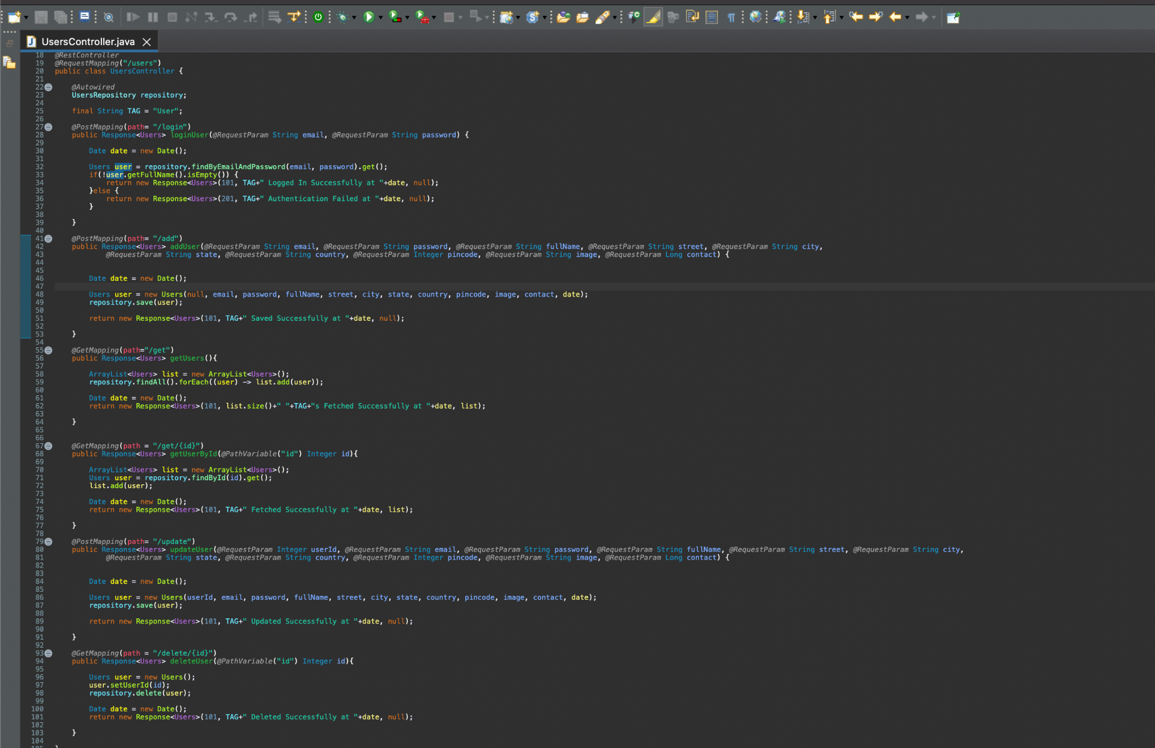
Implementating Micorservice for CRUD: Complete UserController Class
Implement all the remaining controller classes for various models.
Notes:
Now, similarly, implement it for all the remaining Controller classes for various Models

Slide 42
Create APIs
Notes:
Now we will create various Java Classes to serve as controller which will process request and response using to perform CRUD Operations for eStore Backend Project.

Slide 43
CategoriesController.java: Implementation as RestController for Categories
CategoriesController class will handle HTTP Request and Response from the client to perform various CRUD Operations for various categories.
@RestController
@RequestMapping("/categories")
public class CategoriesController {
// implement web methods here
}
Annotate with @RestController to mark it as controller and @RequestMapping will have path as users to reach the controller.
Implement the web methods to perform CRUD operations.
Notes:
CategoriesController class will handle HTTP Request and Response from the client to perform various CRUD Operations for various categories
Annotate with @RestController to mark it as a controller
@RequestMapping will have path as users to reach to the controller
Implement the web methods to perform CRUD operations

Slide 44
ProductsController.java: Implementation as RestController for Products
ProductsController class will handle HTTP Request and Response from the client to perform various CRUD Operations for various products on E-Store.
@RestController
@RequestMapping("/products")
public class ProductsController {
// implement web methods here
}
Annotate with @RestController to mark it as controller, and @RequestMapping will have path as users to reach the controller.
Implement the web methods to perform CRUD operations.
Notes:
ProductsController class will handle HTTP Request and Response from the client to perform various CRUD Operations for various products on eStore
Annotate with @RestController to mark it as a controller
@RequestMapping will have path as users to reach to the controller
Implement the web methods to perform CRUD operations

Slide 45
OrdersController.java: Implementation as RestController for Orders
OrdersController class will handle HTTP Request and Response from the client to perform various CRUD Operations for Orders.
@RestController
@RequestMapping("/orders")
public class OrdersController {
// implement web methods here
}
Annotate with @RestController to mark it as controller and @RequestMapping will have path as users to reach the controller.
Implement the web methods to perform CRUD operations.
Notes:
OrdersController class will handle HTTP Request and Response from the client to perform various CRUD Operations for Orders
Annotate with @RestController to mark it as a controller
@RequestMapping will have path as users to reach to the controller
Implement the web methods to perform CRUD operations

Slide 46
OrderItemsController.java: Implementation as RestController for OrderItems
OrderItemsController class will handle HTTP Request and Response from the client to perform various CRUD Operations for OrderItems.
@RestController
@RequestMapping("/"orderitems)
public class OrderItemsController {
// implement web methods here
}
Annotate with @RestController to mark it as controller and @RequestMapping will have path as users to reach the controller.
Implement the web methods to perform CRUD operations.
Notes:
OrderItemsController class will handle HTTP Request and Response from the client to perform various CRUD Operations for Order Items
Annotate with @RestController to mark it as a controller
@RequestMapping will have path as users to reach to the controller
Implement the web methods to perform CRUD operations

Slide 47
ShipmentsController.java: Implementation as RestController for Shipments
ShipmentsController class will handle HTTP Request and Response from the client to perform various CRUD Operations for Shipments.
@RestController
@RequestMapping("/shipments")
public class ShipmentsController {
// implement web methods here
}
Annotate with @RestController to mark it as controller and @RequestMapping will have path as users to reach the controller.
Implement the web methods to perform CRUD operations.
Notes:
ShipmentsController class will handle HTTP Request and Response from the client to perform various CRUD Operations for Shipments
Annotate with @RestController to mark it as a controller
@RequestMapping will have path as users to reach to the controller
Implement the web methods to perform CRUD operations

Slide 48
CartController.java: Implementation as RestController for Cart
CartController class will handle HTTP Request and Response from the client to perform various CRUD Operations for User’s Shopping Cart.
@RestController
@RequestMapping("/cart")
public class CartController {
// implement web methods here
}
Annotate with @RestController to mark it as controller and @RequestMapping will have path as users to reach the controller.
Implement the web methods to perform CRUD operations.
Notes:
CartController class will handle HTTP Request and Response from the client to perform various CRUD Operations for User’s Shopping Cart
Annotate with @RestController to mark it as a controller
@RequestMapping will have path as users to reach to the controller
Implement the web methods to perform CRUD operations

Slide 49
WishlistController.java: Implementation as RestController for Wishlist
WishlistController class will handle HTTP Request and Response from the client to perform various CRUD Operations for User’s Wishlist.
@RestController
@RequestMapping("/wishlist")
public class WishlistController {
// implement web methods here
}
Annotate with @RestController to mark it as controller and @RequestMapping will have path as users to reach the controller.
Implement the web methods to perform CRUD operations.
Notes:
WishlistController class will handle HTTP Request and Response from the client to perform various CRUD Operations for User’s Wishlist
Annotate with @RestController to mark it as a controller
@RequestMapping will have path as wishlist to reach to the controller
Implement the web methods to perform CRUD operations

Slide 50
Build and Execute

Slide 51
Run the Project as Spring Boot App

Slide 52
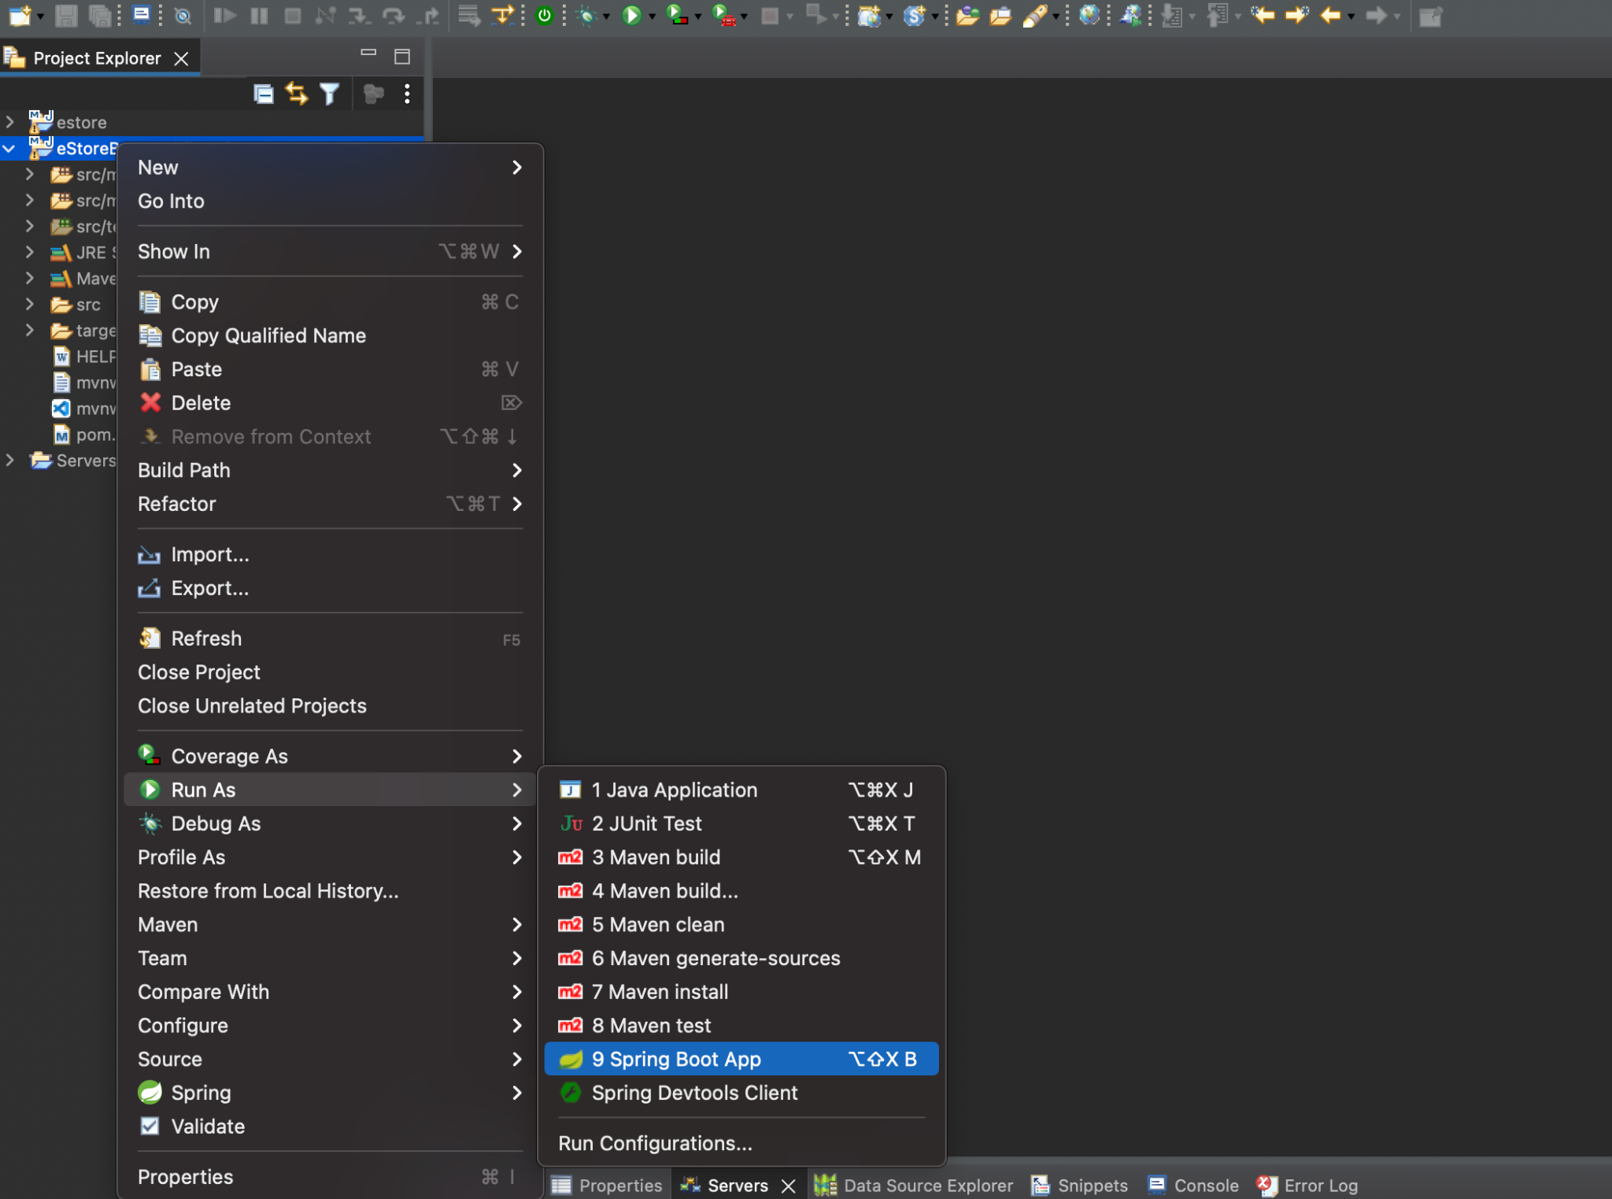
Run the Project as Spring Boot App
Simply click on the run icon and select run as spring boot app.
Right click
Run as spring boot app
Notes:
Right click on the project and run as Spring Boot App
Or
Simply click the run icon and select run as spring boot app

Slide 53
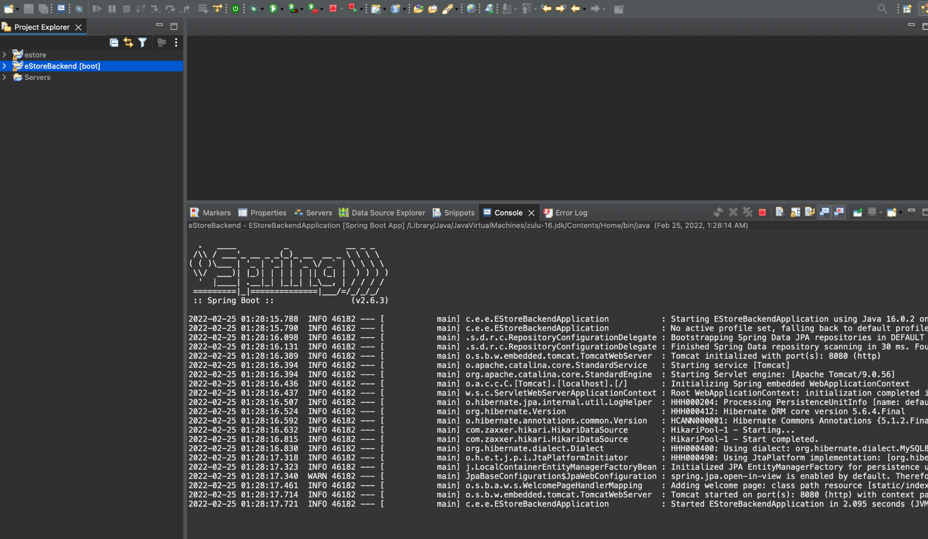
Project Run Output Logs
Check in the console if the application is running successfully on Tomcat Port 8080.
In case 8080 port is blocked, go to application.properties file and change the server port number.
Notes:
Check in the console if the application is running successfully on Tomcat Port 8080.
In case 8080 port is blocked, go to application.properties file and change the server port number

Slide 54
Execute the Project on localhost 8080 with Tomcat

Slide 55
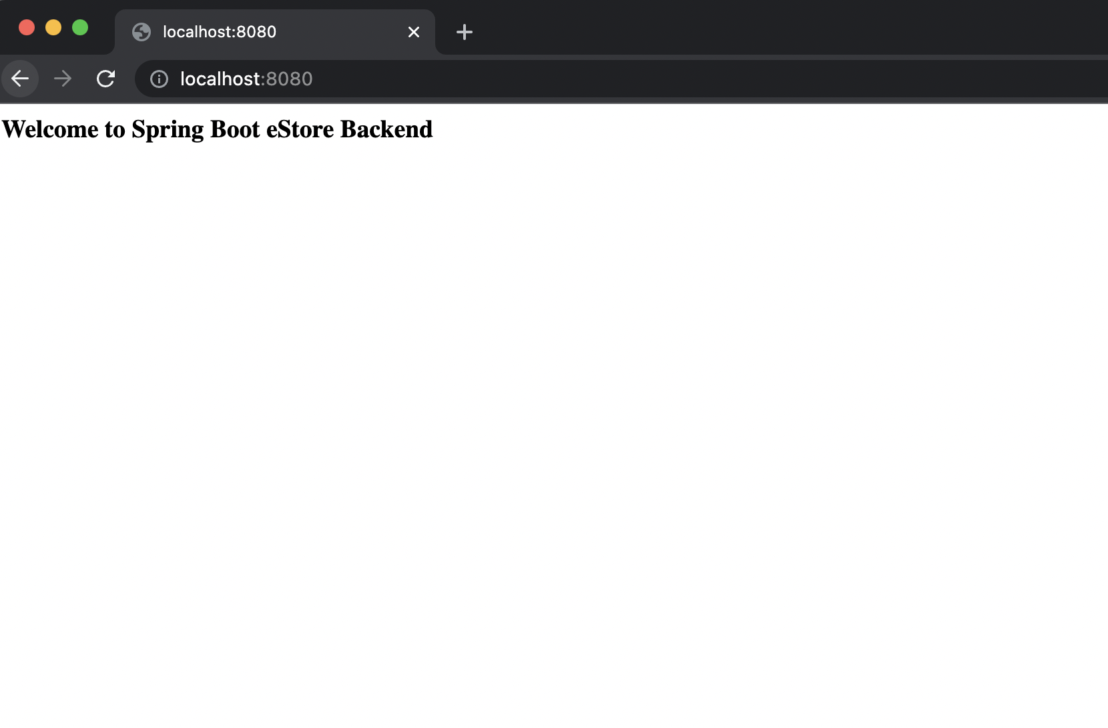
Project on localhost:8080
Open the web browser and type localhost:8080. The index.html web page will be loaded automatically.
Notes:
Open the web browser and type localhost:8080, index.html web page will be loaded automatically

Slide 56
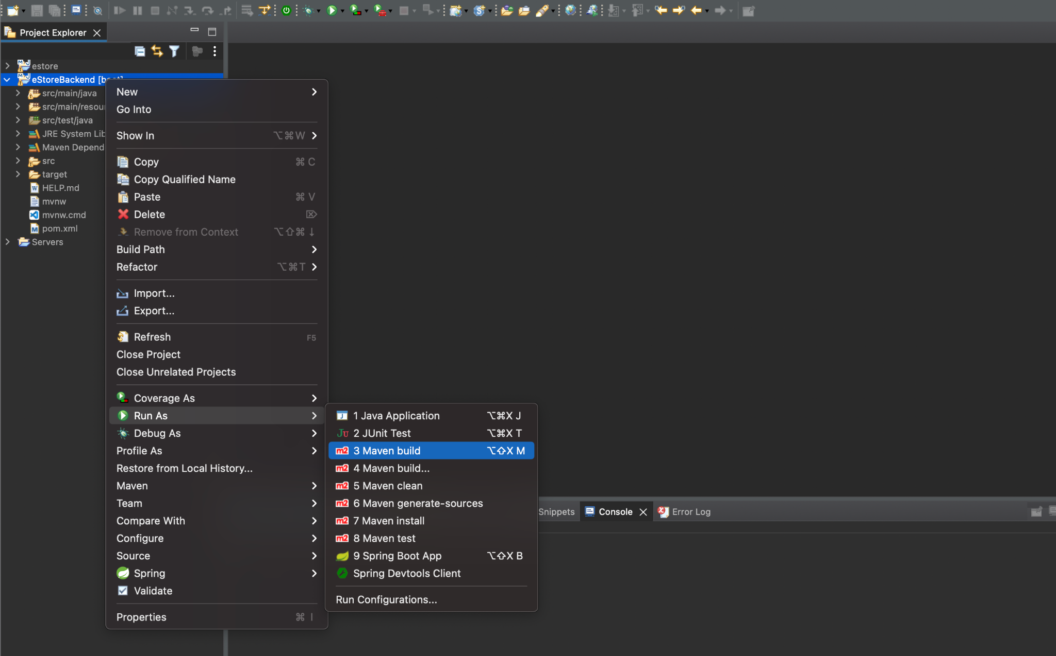
Build the Project Using Maven and Create a Jar
Before you build the project with Maven for jar, stop the running project in Eclipse.
right-click
right-click
Run as Maven Build
Notes:
Before you build the project with maven for jar, stop the running project in eclipse.
And then, Right click on the project and run as Maven Build

Slide 57
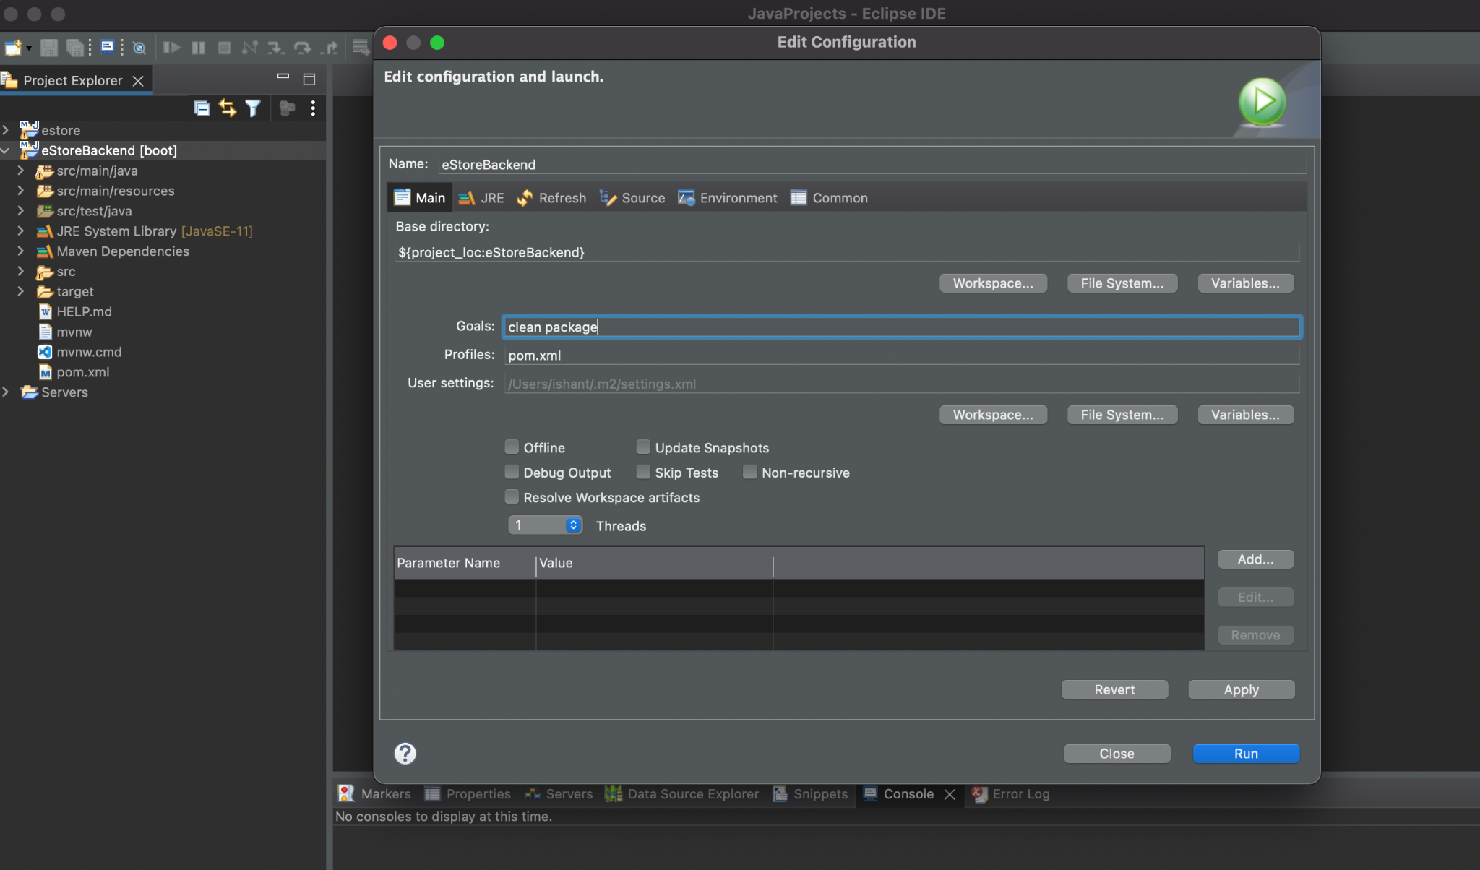
Build the Project Using Maven and Create a Jar
Pass clean package in the Goals.
Notes:
In the goals pass - clean package

Slide 58
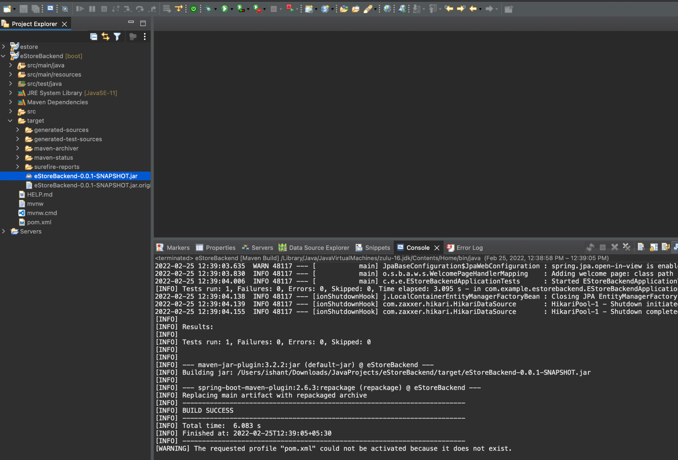
Build the Project Using Maven and Create a Jar
Check the targets directory and have a jar file for the project by the name of eStoreBackend-0.0.1-SNAPSHOT.jar.
Execute the same using the command: java -jar eStoreBackend-0.0.1-SNAPSHOT.jar
Notes:
check the targets directory, we will have jar file for our project by the name of eStoreBackend-0.0.1-SNAPSHOT.jar
You can execute the same using command: java -jar eStoreBackend-0.0.1-SNAPSHOT.jar

Slide 59
Test the API End Points with Postman for Request and Response
Notes:
Let us now launch the postman in the chrome browser and test the UserController End Points
Make sure your SringBoot Application is running successfully before we test

Slide 60
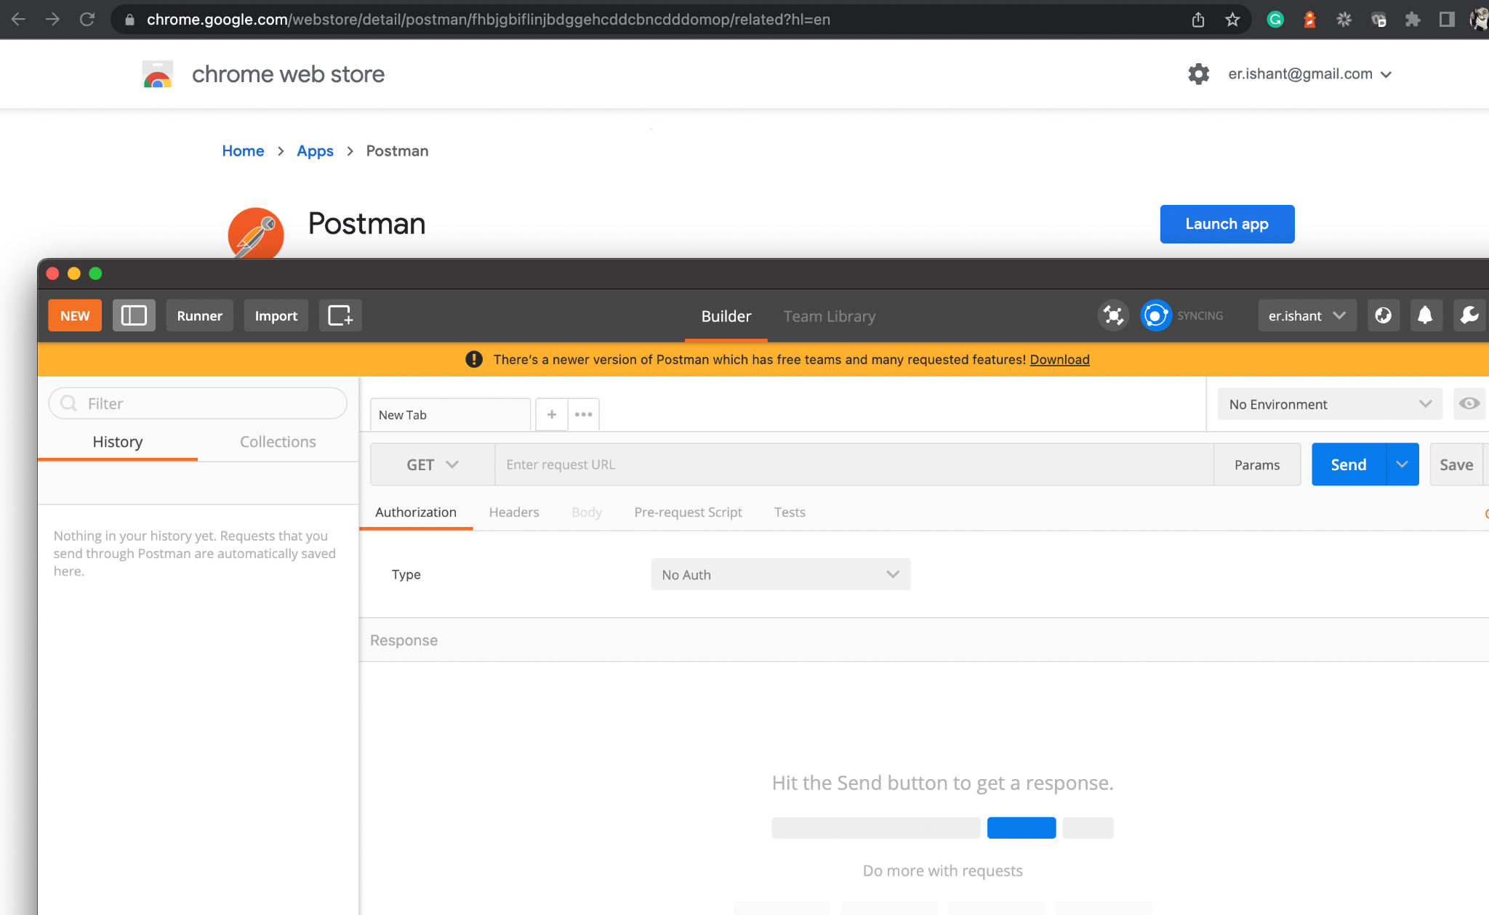
Launch the Postman App from Chrome Web Browser
Using the Chrome web browser, open the Postman App.
Notes:
Launch the Postman App.

Slide 61
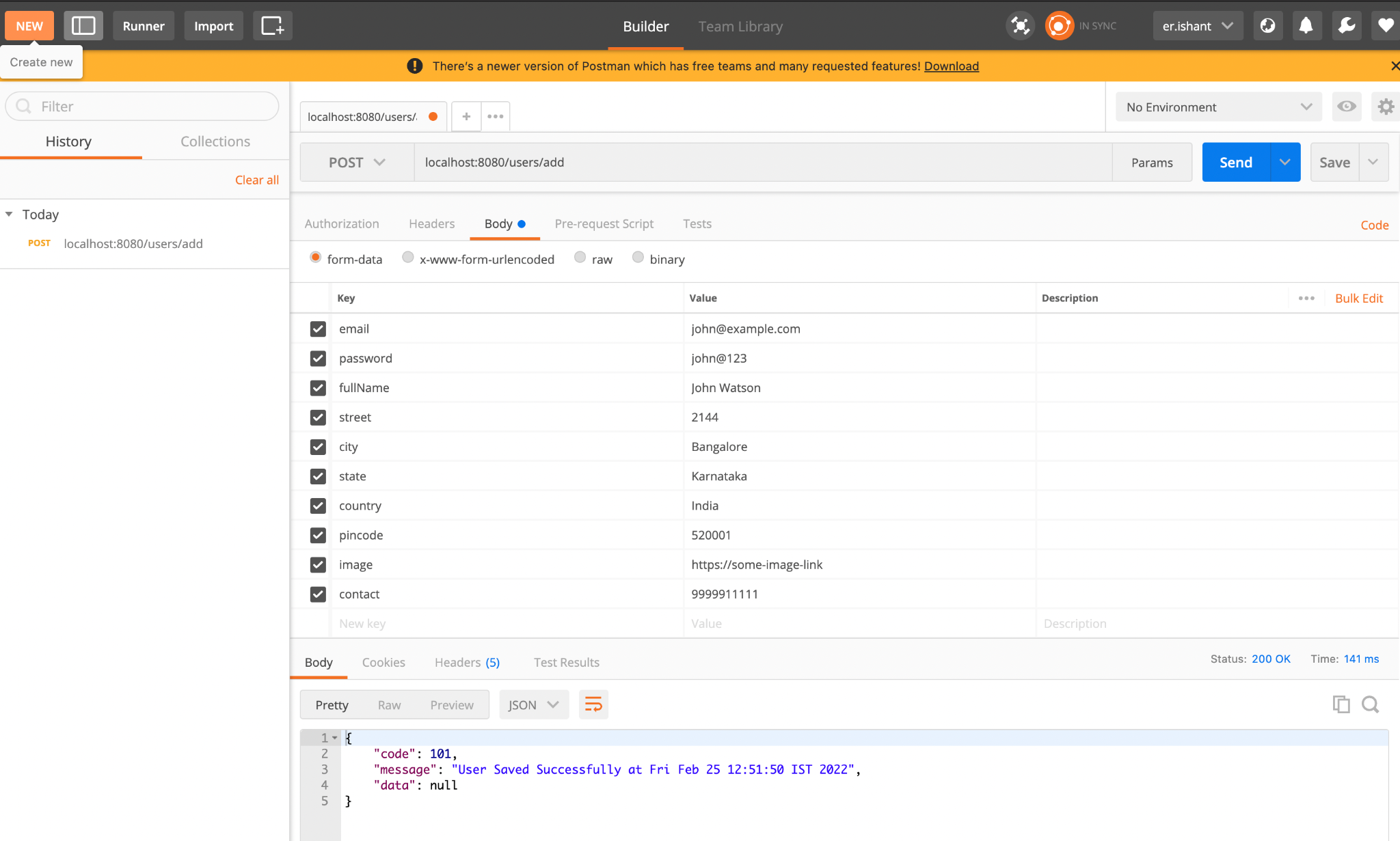
Test Add User on Postman from UsersController
Use the API End point localhost:8080/users/add to add a new user.
Fill in the attributes and values for the POST request and click send button.
JSON response in return once, the user is saved successfully in database.
Notes:
Use the API End point localhost:8080/users/add to add a new User
Fill in the attributes and values for the POST request and click send button
You will get a JSON response in return once, the User is saved successfully in database

Slide 62
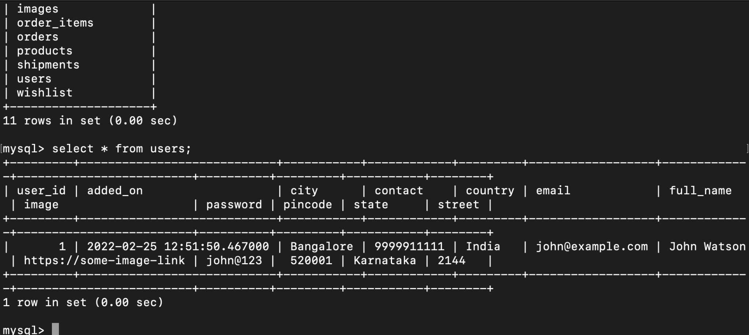
Check User Record in DataBase
In the database, a record has been successfully added and similarly, can add more users.
Notes:
In the database you can see the record has been successfully added.
Similarly now you can add more users.

Slide 63
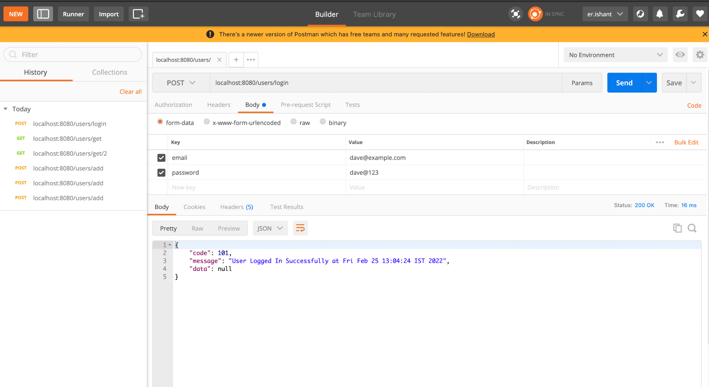
Test Login User on Postman from UsersController
Use the API End point localhost:8080/users/login to login a user.
Fill in the attributes email and password as values for the POST request and click on the send button.
Once the JSON response is returned the user is fetched from the database.
Notes:
Use the API End point localhost:8080/users/login to login a User
Fill in the attributes email and password as values for the POST request and click send button
You will get a JSON response in return once, the User is fetched from the database

Slide 64
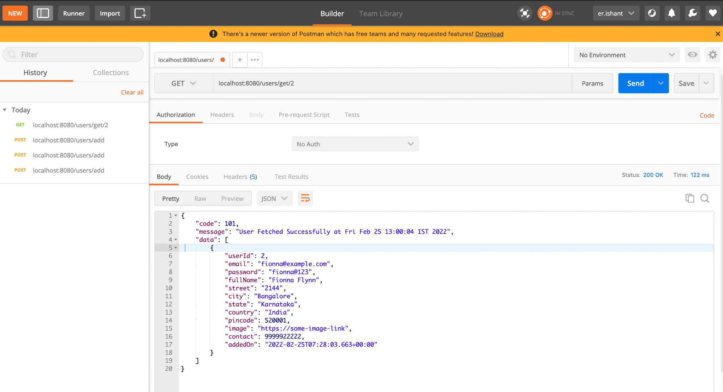
Test Get Single User on Postman from UsersController
Use the API End point localhost:8080/users/get/2 to get user with id as 2.
Create a Get request and click on send.
A JSON response is returned once, with user details.
Notes:
Use the API End point localhost:8080/users/get/2 to get User with id as 2
Create a Get Request and click on Send
You will get a JSON response in return once, with User Details

Slide 65
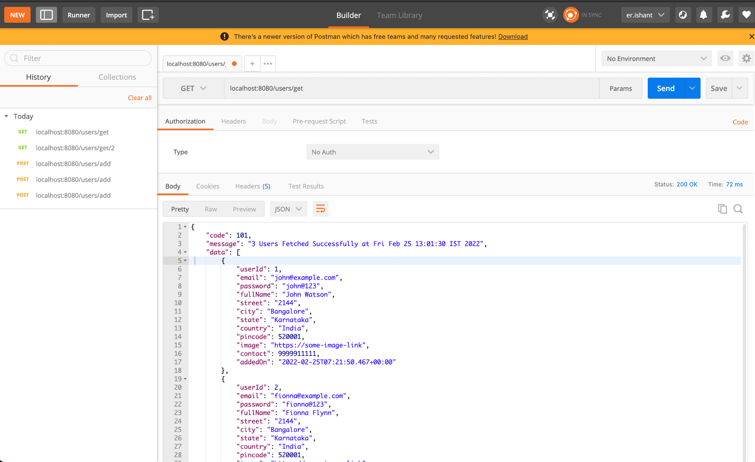
Test Get All Users on Postman from UsersController
Use the API End point localhost:8080/users/get to get all the users as list.
Create a Get request and click on send.
JSON response in return once, with list of users in data key of JSON.
Notes:
Use the API End point localhost:8080/users/get to get all the Users as List
Create a Get Request and click on Send
You will get a JSON response in return once, with List of Users in data key of JSON

Slide 66
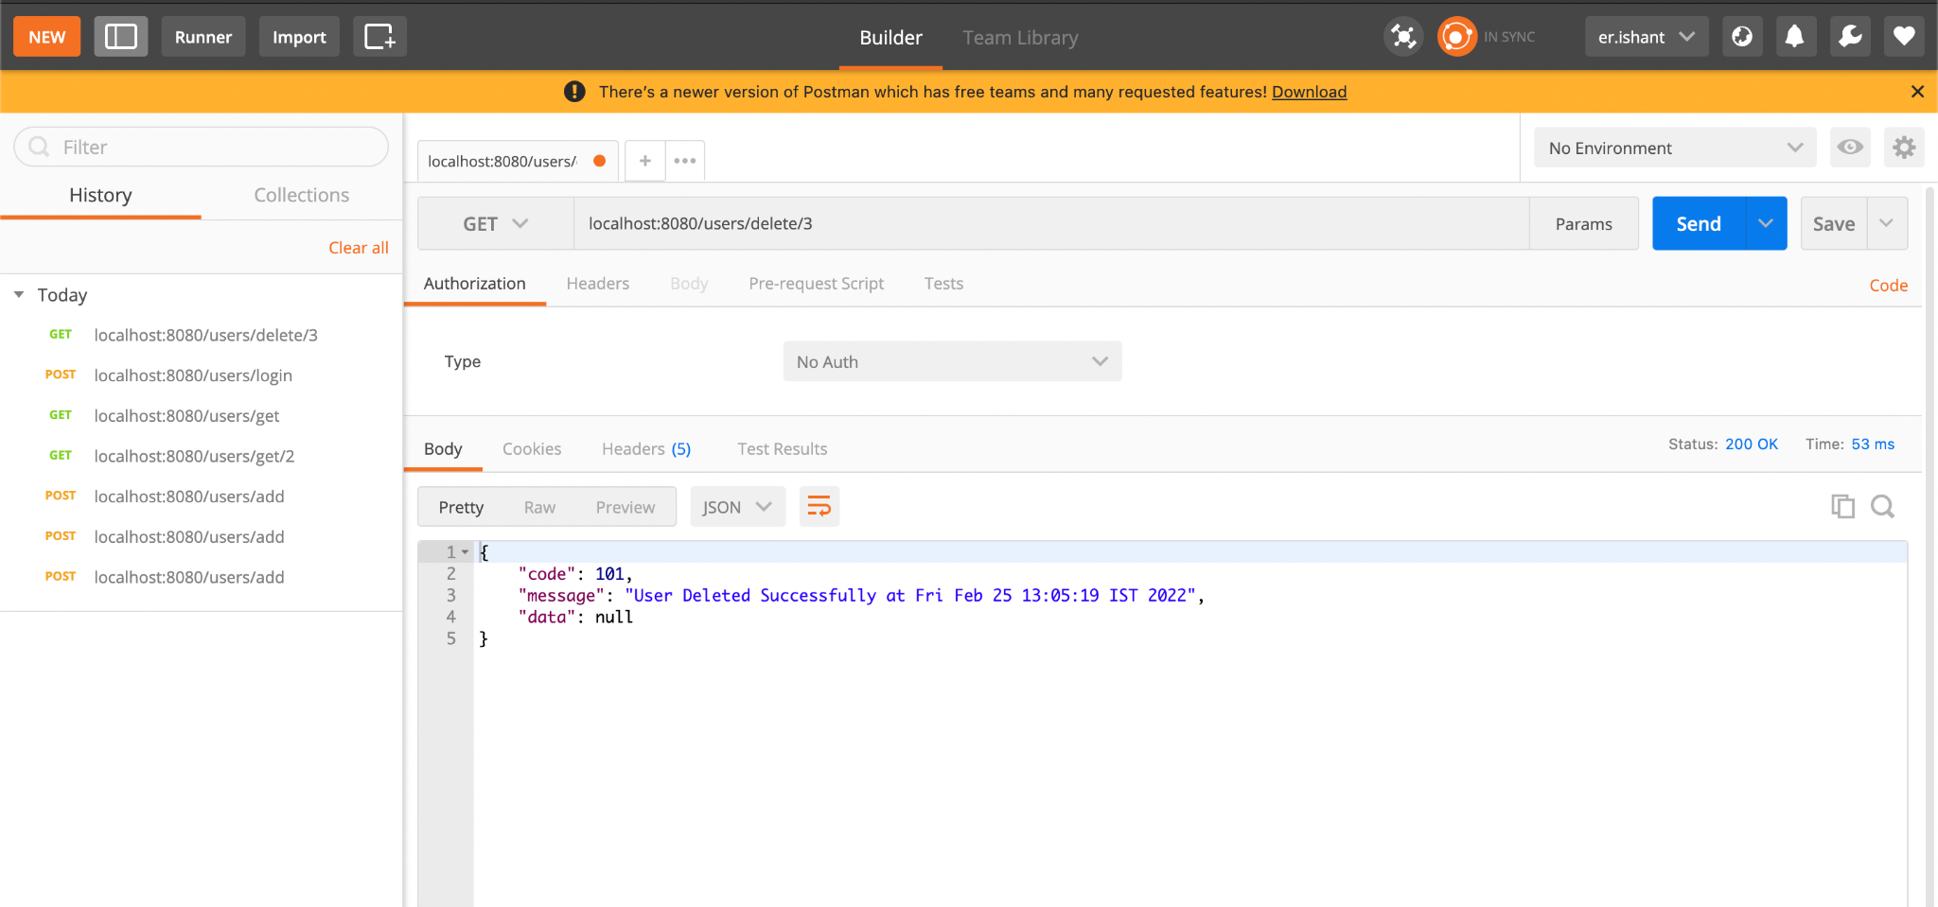
Test Delete User on Postman from UsersController
Use the API End point localhost:8080/users/delete/3 to get user with id as 3.
Create a Get request and click on send.
Once with user deleted the message or can check the same from the DB. The user with ID as 3 would have been deleted.
Notes:
Use the API End point localhost:8080/users/delete/3 to get User with id as 3
Create a Get Request and click on Send
You will get a JSON response in return once, with User deleted message.
You can check the same from the DB. User with Id 3 would have been deleted

Slide 67
Implemented RestControllers in Spring Boot
Developed MicorServices to process HTTP Request
Implemented CRUD Operations for various models per request in Controllers
Tested the Service End Points on Postman

Slide 69
Which annotation can be used to create a Controller?
01
@Controller
@RestController
Both A and B
None of the above

Slide 70
Which annotation can be used to create a Controller?
01
@Controller
@RestController
Both A and B
None of the above
C
Both Controller and RestController annotations can be used. RestController will send the response as JSON.

Slide 71
Where is servlet mapping declared?
02
@RequestParam
@Controller
@PostMapping
@GetMapping

Slide 72
Where is servlet mapping declared?
02
@RequestParam
@Controller
@PostMapping
@GetMapping
A
Declare @RequestParam with the input arguments in the web method.

Slide 73
Which method will be used to update an object in CrudRepository?
03
save
update
updateObject
find

Slide 74
Which method will be used to update an object in CrudRepository?
03
save
update
updateObject
find
A
The save method is used for both insert and update operations. You need to pass the id of object for save method to perform an update operation.

Slide 75
Which is the correct usage of Path variable?
04
localhost:8080/user/get/id=2
localhost:8080/user/get?id=2
localhost:8080/user/get/id:2
localhost:8080/user/get/2

Slide 76
Which is the correct usage of Path variable?
04
localhost:8080/user/get/id=2
localhost:8080/user/get?id=2
localhost:8080/user/get/id:2
localhost:8080/user/get/2
D
For path variable, we use @GetMapping(path = "/get/{id}") annotation and pass the id in the URL path directly.

Slide 77
For implementing the login, what will be the correct method declaration in
CrudRepository interface?
05
public Optional<Users> findByUserId(Integer userId);
public Optional<Users> findByEmailAndPassword(String email, String password);
public Optional<Users> findByEmail(IString email);
public Optional<Users> findByPassword(IString password);

Slide 78
For implementing the login, what will be the correct method declaration in
CrudRepository interface?
05
public Optional<Users> findByUserId(Integer userId);
public Optional<Users> findByEmailAndPassword(String email, String password);
public Optional<Users> findByEmail(IString email);
public Optional<Users> findByPassword(IString password);
B
Create a method findByEmailAndPassword in the Repository, which will be defined automatically for us to perform
the login operation.

Slide 79
Before the Next Class
You have successfully completed this session. Before the next discussion, you should go through:
Docker
Jenkins

Slide 80
What’s Next?
Now we have finished our Classes and Design Pattern for the Backend Project wrt End Usermodule. In our next live session, we will :
See Front End and Back End Communication
See how to connect to MicroServices from Angular App
Learn to use ASS S3 bucket to upload product images
Complete both Admin and End User Projects with Backend Connectivity

